Slide 1
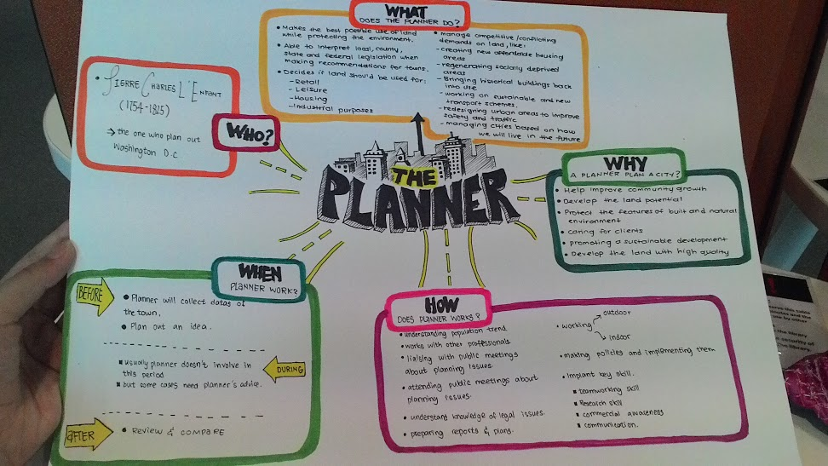

Slide 2
TOWN PLANNER
Tham Kai Loon
Yeoh Sin Yuen
Tan Tee Jane
Yew Weng Kee
Tan Yan Jie
Zachary Ooi Cheng En

Slide 3
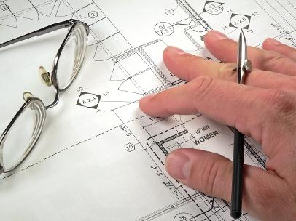

Slide 4
WHAT DOES THE PLANNER DO?
What is Planner?
Involved in making long and short-term decisions about the management and development.
Shapes the way towns and cities will develop.
Creates the vision for the community, identifies current problems, analyzes trends, engages community members in dialogue about goals and issues, and sets the framework for growth and change.
Make positive contribution towards the development.
Able to interpret legislation when making recommendations.
(In some instances, planner may help official to draft a new legislation too)
Anticipate how a city will function and how will it look.

Slide 5
Create new housing
Regenerates socially deprived areas
Bring historical buildings back into use
Works on sustainable transport measure
Protect areas of natural environment while working on town development

Slide 6
RESPONSIBILITIES OF A PLANNER
To ease or overcome current problems in the community of the town
Balance the social, economic and environmental problems
Achieved by making recommendation to officials
Recommendations for neighborhood sectors or citywide
Ensures that the environment, economy & society are continuously flourishing

Slide 7
DUTIES OF A PLANNER
Involved before construction phase
Research of data, etc: traffic problems,
Attend meetings to receive client’s brief & then present findings/solutions/recommendations
Organising meetings to listen to ideas and hear concerns about planning proposals from the community
Write reports based on layout plans

Slide 8
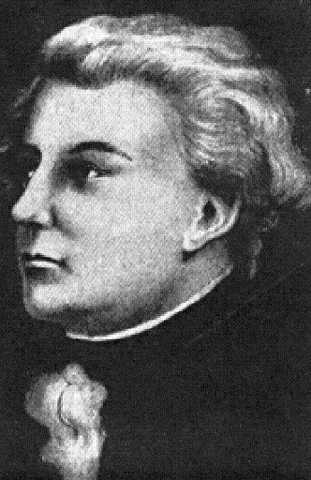
PIERRE CHARLES L’ ENFANT
(1754-1825)
French-born American
Architect, Civil Engineer & Planner
Designed the layout of the streets of Washington, D.C., the L'Enfant Plan

Slide 9
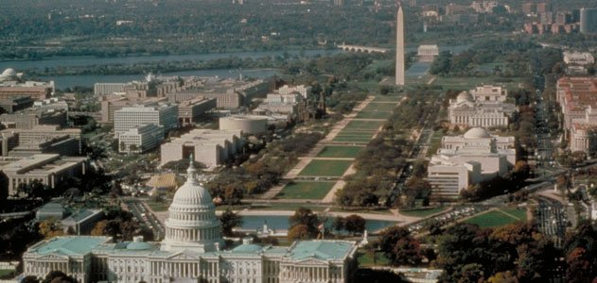
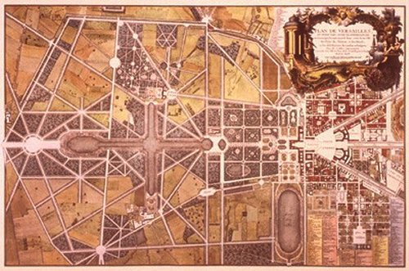
View of the National Mall
Plan of Washington, D.C.

Slide 10
Plan out an idea
Before construction
Usually planner doesn’t involve in this period, but so have some specific cases that need planner’s advice
During construction
Review and compare to the expectation and reality of the town.
After construction

Slide 11
Drawings and Diagrams

Slide 12
What type of drawing does planner use?
Planner do read a lot of drawing everyday, and that’s a lot of drawing they need to analyses and understand, and these are the drawing which planner need to read.
Bubble Diagram
Masterplan
Zoning Diagram

Slide 13
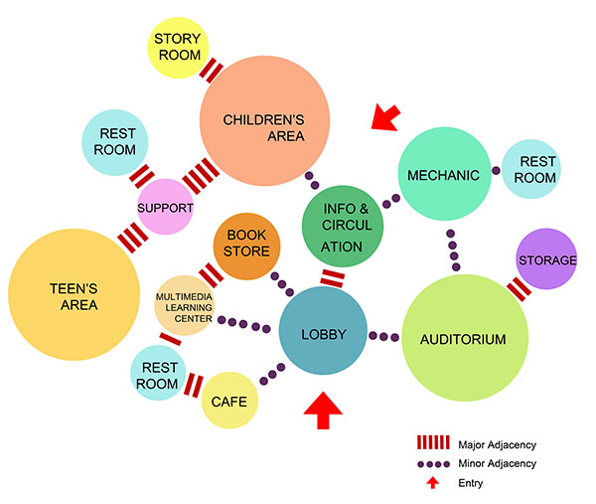
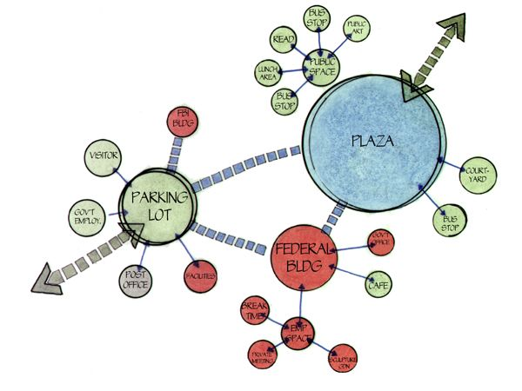
Bubble Diagram
a diagram which represents information visually in the form of a series of bubbles.
used to present a wide variety of information for the purpose of activities
presentations, planning out designs, and developing strategy.

Slide 14
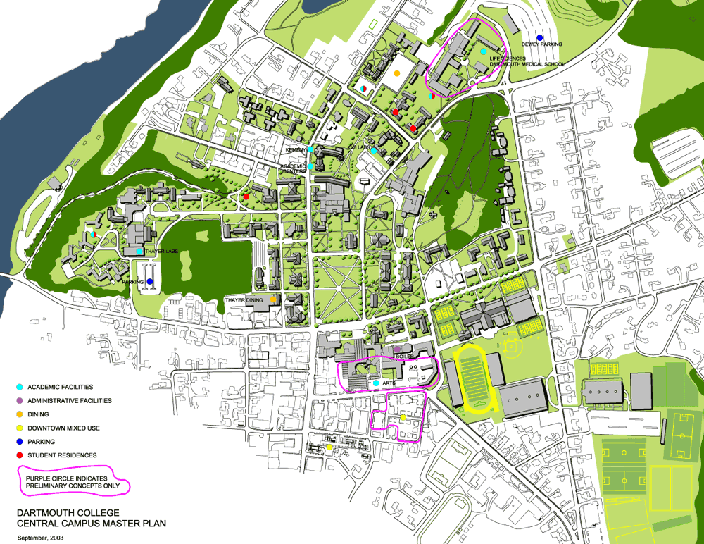
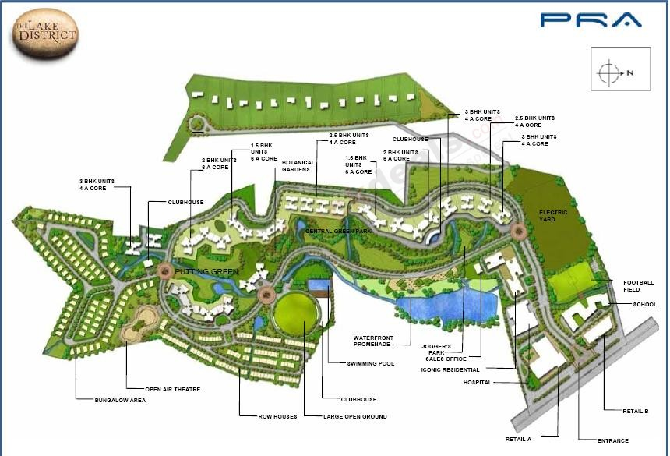
Master Plan
long term perspective plan for guiding the sustainable planned development of the city.
It lays down the planning guidelines, policies, development code and space requirements for various socio-economic activities supporting the city population
It is also the basis for all infrastructure requirements.

Slide 15
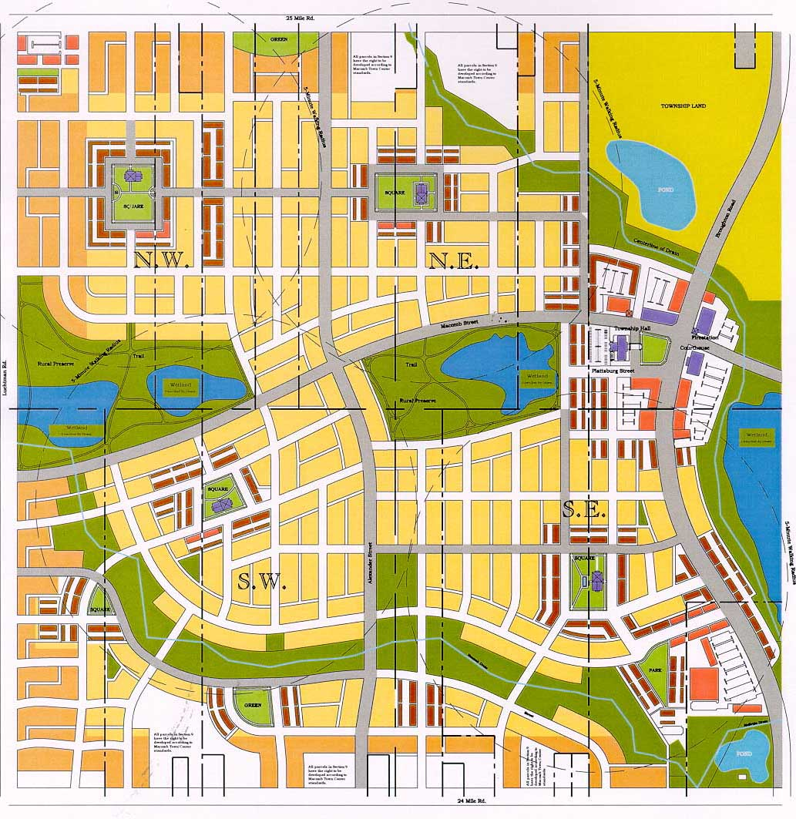
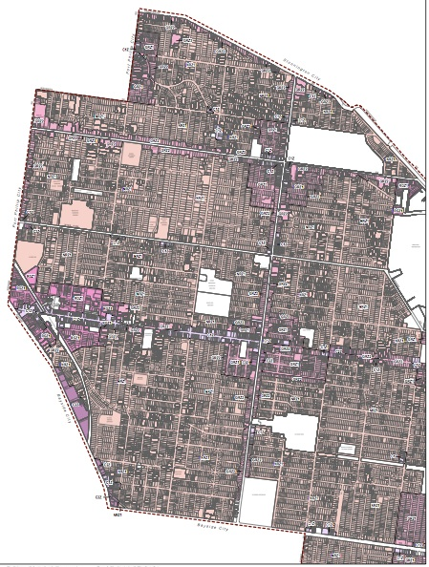
Zoning Map
the process of planning for land use across geographic areas
can help avoid the mixing of incompatible land uses.
This has both environmental and economic benefits.

Slide 16
Drafting when get requested by client
Bubble diagram
Zoning Diagram
Zoning when collected the data from the land
Master Plan
Present to client about the final works

Slide 17
Thank You

